Slide 1

Image Compression by K-Means Clustering
By; (William) Austin Gay

Slide 2
Project Specifics
Goal/Problem: Image Compression
Method: K-Means Clustering
Applied to sub-images of an image
Grayscale Pictures
Python

Slide 3
K-Means Clustering Algorithm
Looks for k clusters in a dataset (mean/centroid)
Initially, chooses k centroids at random which serve as the center of the clusters
Assigns each data point to its nearest cluster
Calculates new centroid by averaging data assigned to each cluster
Repeats calculations until the centroid doesn’t move or the max iterations is reached
To summarize: K-Means Clustering Algorithm clusters data by assigning it to the cluster with the nearest mean

Slide 4
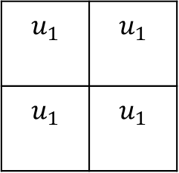
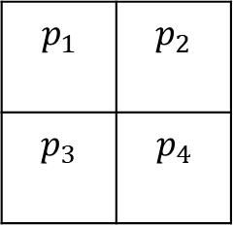
Problem: Image Compression
Goal is to achieve image compression by decreasing the number of colors used in an image (note: the method used will not decrease the size of the image)
Image is split into sub-images that are run through k-means clustering
Sub-images will be filled with the same-colored pixels at the end of the algorithm
Sub-image belongs to cluster 1
Cluster 1 average replaced pixels in sub-image
$$p_{1}$$ | $$p_{2}$$
$$p_{3}$$ | $$p_{4}$$
$$u_{1}$$ | $$u_{1}$$
$$u_{1}$$ | $$u_{1}$$

Slide 5
Questions/Experimental Focus
Number of Sub-Images
Number of Clusters
Clarity of image
Still Recognizable
Image Compression

Slide 6
Experimental Results

Slide 7
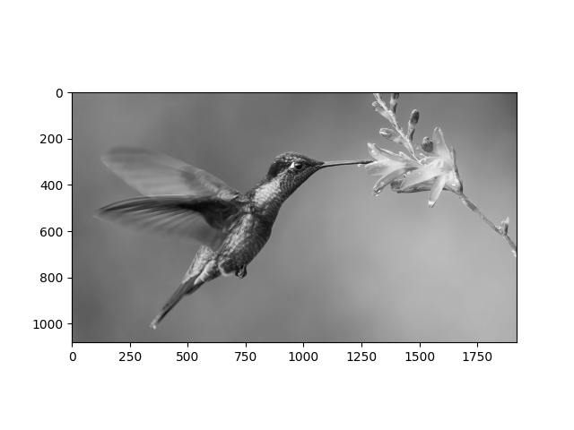
Base Picture in Grayscale

Slide 8
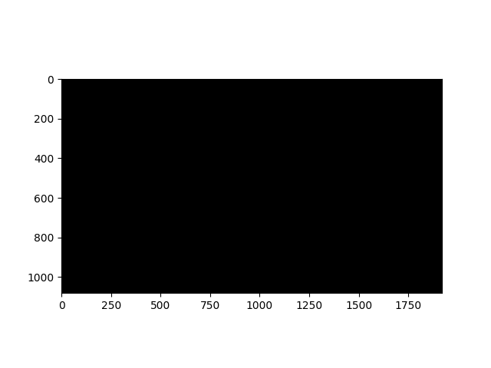
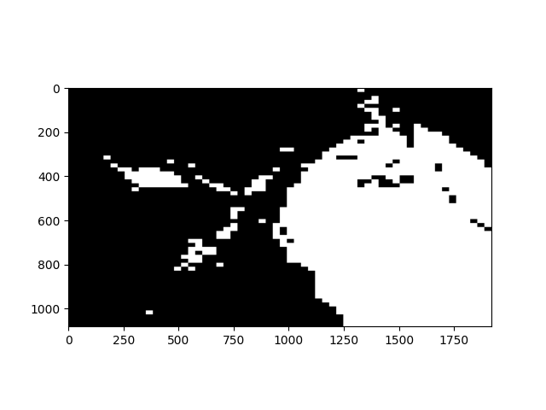
Number of Clusters (60x60 sub-images)
1 cluster
2 clusters

Slide 9
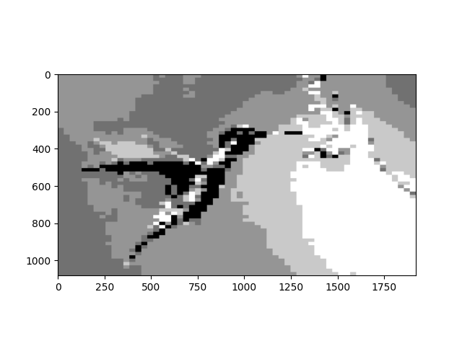
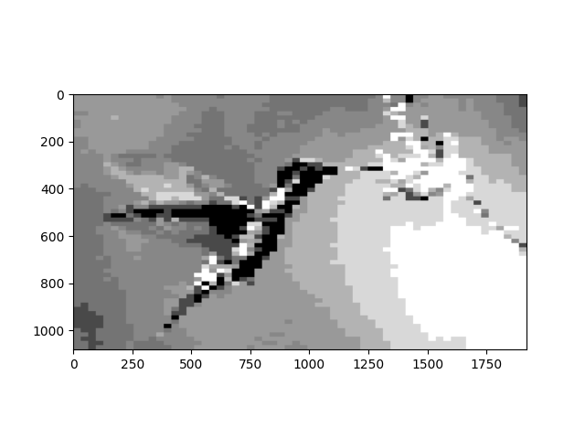
Number of Clusters (60x60 sub-images)
5 clusters
10 clusters

Slide 10
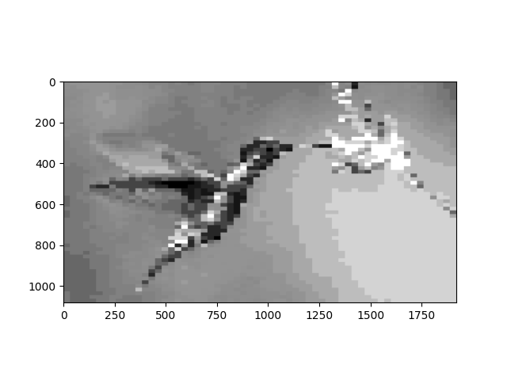
Number of Clusters (60x60 sub-images)
Original
25 Clusters

Slide 11
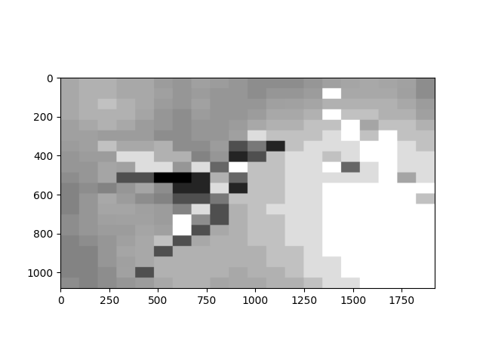
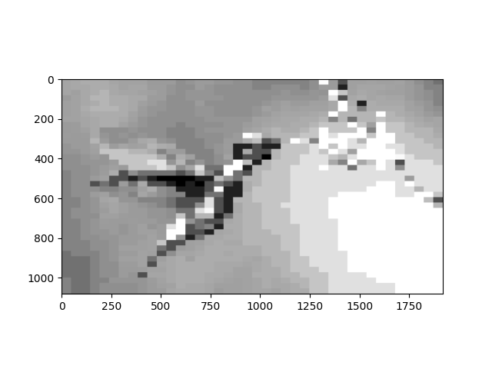
Number of Sub-Images
20x20 sub-images
40x40 sub-images

Slide 12

Number of Sub-Images
60x60 sub-images
120x120 sub-images

Slide 13
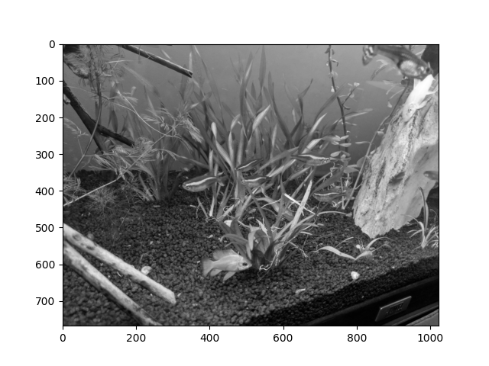
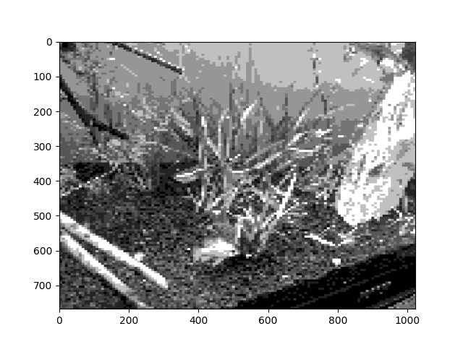
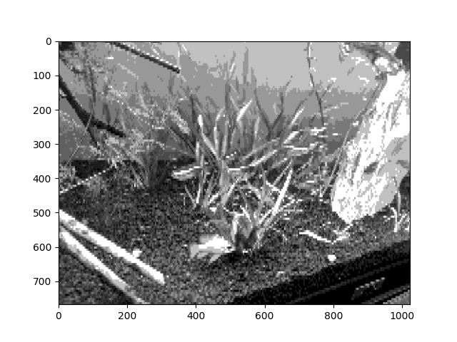
Number of Sub-Images
120x120 sub-images
128x256 sub-images

Slide 14
Observations
After 5-10 clusters you can easily make out most pictures.
The amount of sub images impacts the clarity of the image the most
More complicated images require more sub-images to maintain content
Overall, a good all-around number that seems to be very efficient is 60x60 with 10+ cluster.

Slide 15
Future Work
RGB Pictures
Compare Sub-Image Method to Individual Pixel Method
Instead of eyesight, use classification to determine if a picture retained its contents after image compression

